Slide 1
FOR375 Introduction to Remote Sensing Spring 2016
Lecture 7 – Introduction & Remote Sensing

Slide 2
Introduction to Remote Sensing
Learning Objectives:
what remote sensing is and how it can be used for obtaining primary data
value of the overhead perspective – context, patterns, adjacencies
basic concepts of spatial, spectral, temporal and radiometric resolution
converting raw spectral images into information outputs or maps – image classification using statistical classifiers

Slide 3
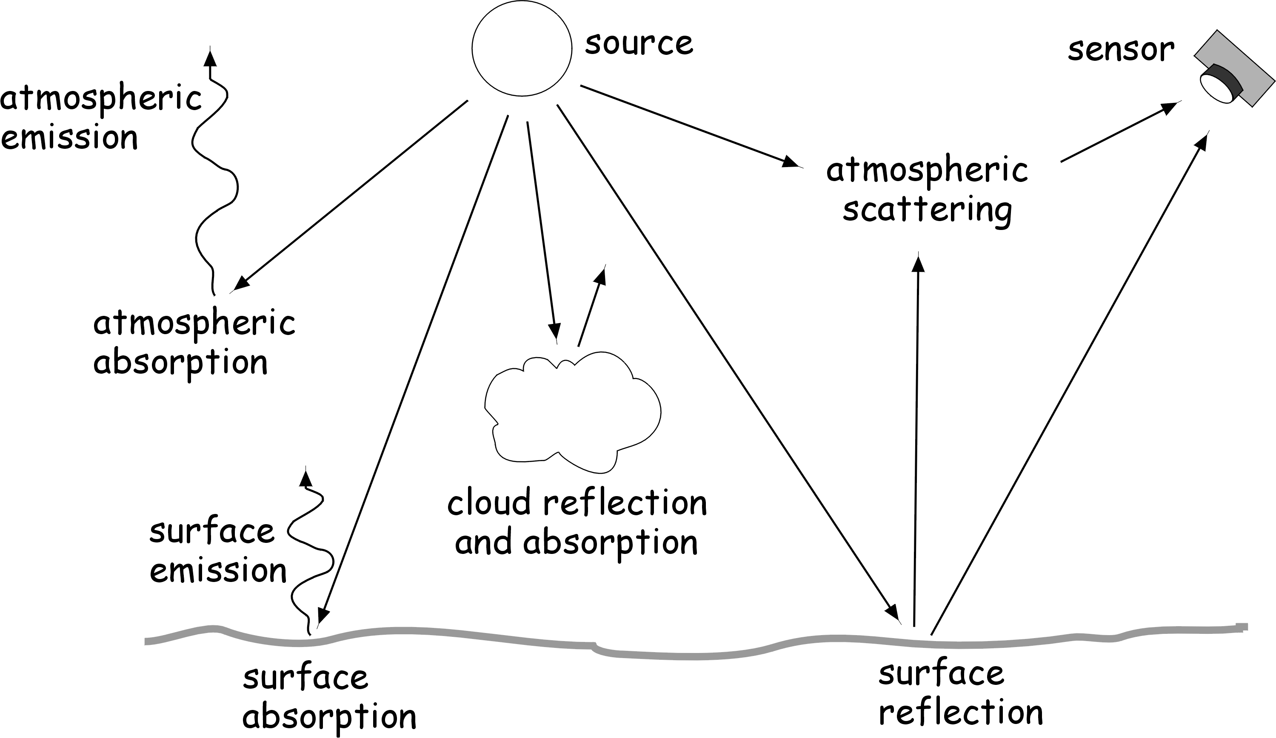
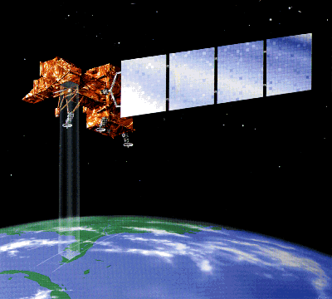

Remote sensing is the practice of deriving information about the earth's land and water surfaces using images acquired from an overhead perspective, using electromagnetic radiation in one or more regions of the electromagnetic spectrum, reflected or emitted from the earth's surface. Campbell, 1996

Slide 4
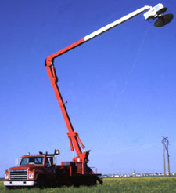
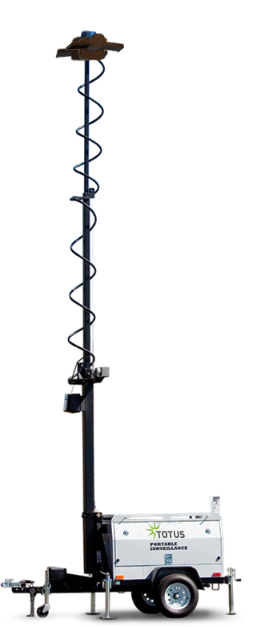
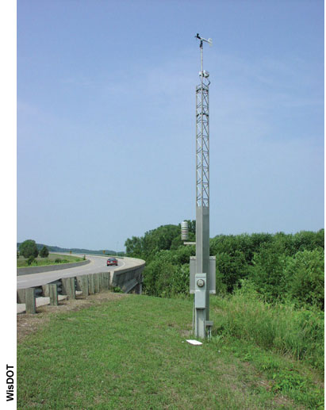
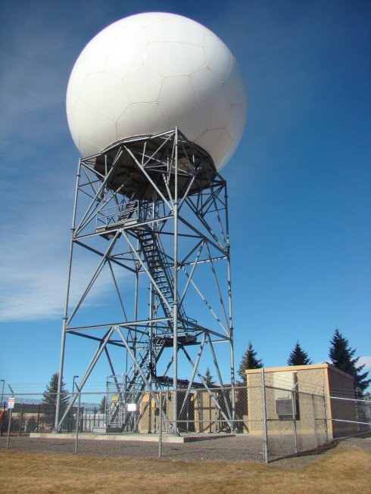
Types of Remote Sensing
Ground based platforms
Airborne based platforms
Space based platforms

Slide 5
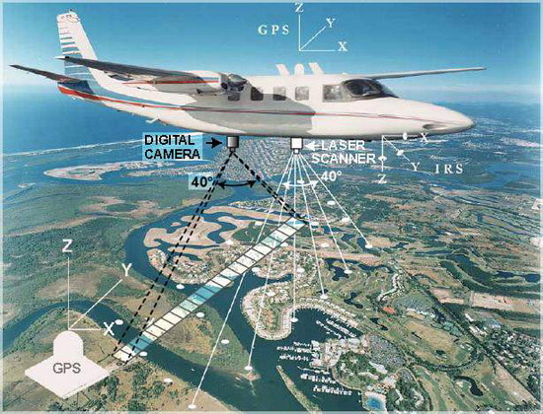
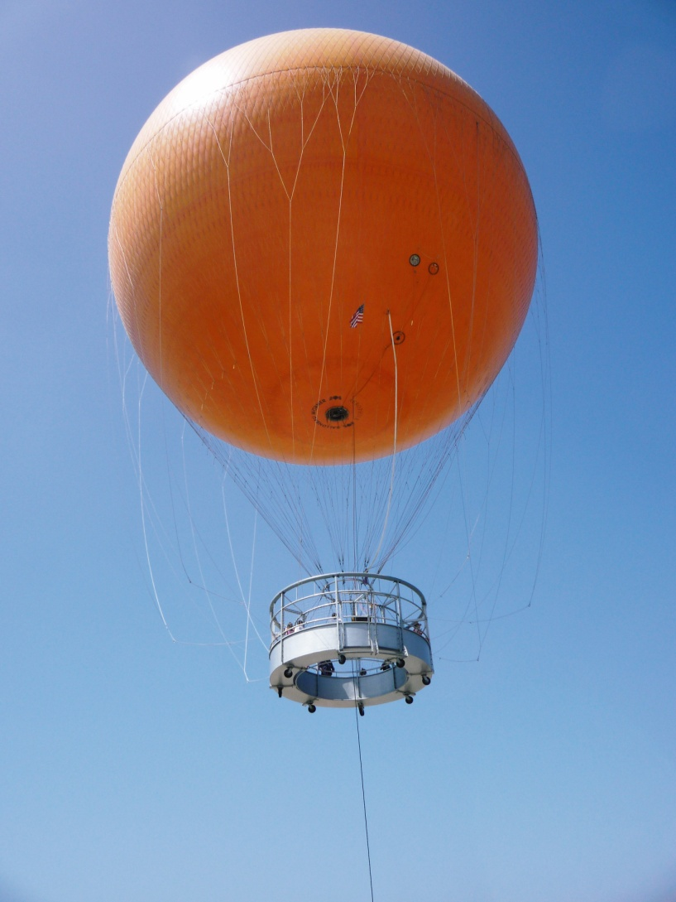
Types of Remote Sensing
Ground based platforms
Airborne based platforms
Space based platforms

Slide 6
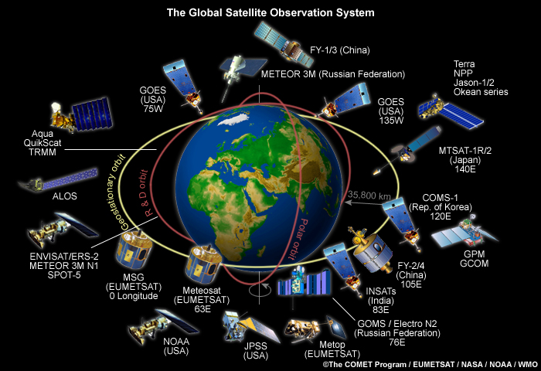
Types of Remote Sensing
Ground based platforms
Airborne based platforms
Space based platforms

Slide 7
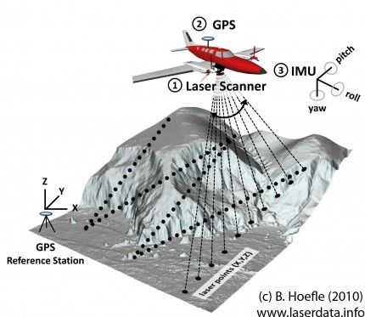
Lidar
LIDAR is a surveying technology that measures distance by illuminating a target with a laser light. The term lidar was created as a combination of the words "light" and "radar". Lidar uses ultraviolet, visible, or near infrared light to image objects. It can target a wide range of materials, including non-metallic objects, rocks, rain, chemical compounds, aerosols, clouds or single molecules. A narrow laser-beam can map physical features with very high resolutions.

Slide 8
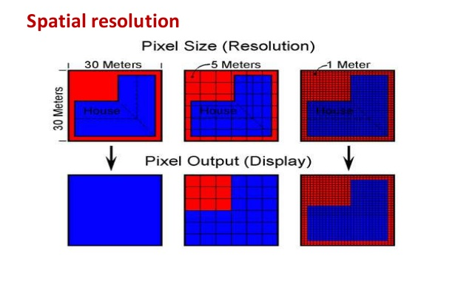
Resolution
The process or capability of making distinguishable the individual parts of an object.
We may measure resolution (i.e. how distinguishable objects are) in differing ways for differing processes.
Time, location, degree of detail, multi-spectral properties

Slide 9
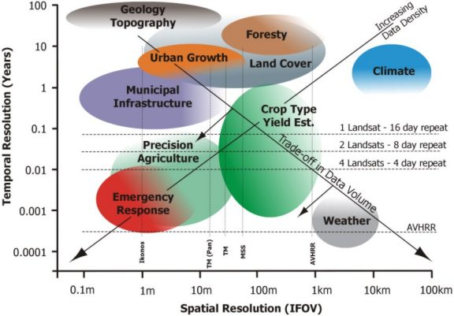
Types of resolution
Spatial resolution – spatial detail & geographic extent
Spectral resolution – colors or spectral differentiation (wavelength differentiation)
Temporal resolution – when, or how often (monitoring)
Radiometric resolution – how many gray levels, or levels of brightness differentiation

Slide 10
Types of resolution
Spatial resolution – what size can I observe?
Spectral resolution – what wavelengths can I observe?
Temporal resolution – how often do you observe?
Radiometric resolution – degree of detail observed?

Slide 11
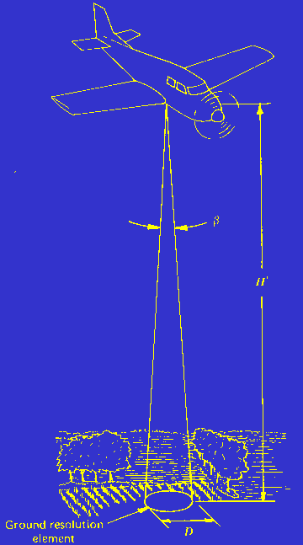
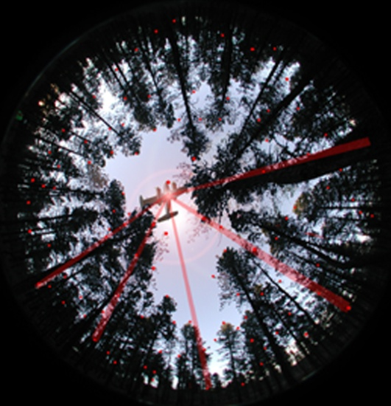
Instantaneous field of view (IFOV)
Instantaneous Field of View (IFOV):
the area viewed by the instrument if it were possible to suspend the motion of the aircraft (satellite platform) and the scanning of the sensor for an instant
LiDAR spatial resolution: fundamentally different

Slide 12
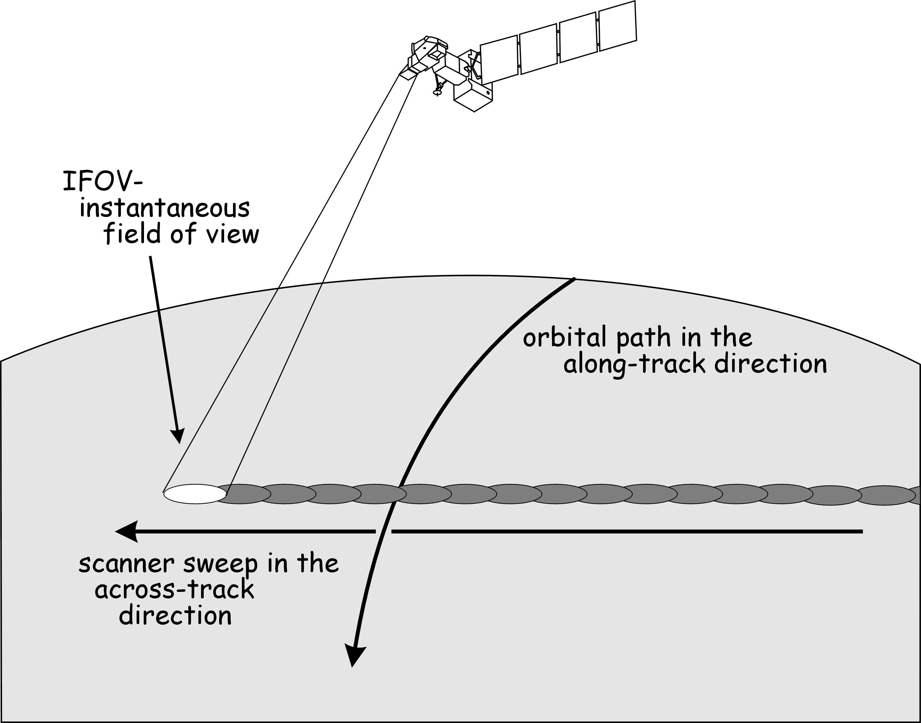
Instantaneous field of view (IFOV)

Slide 13
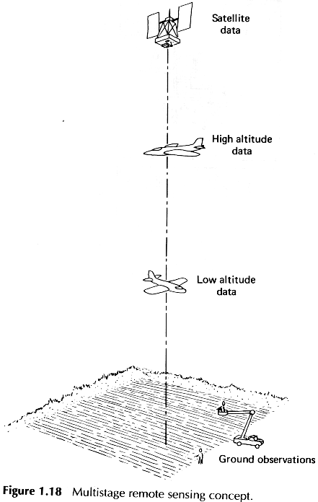
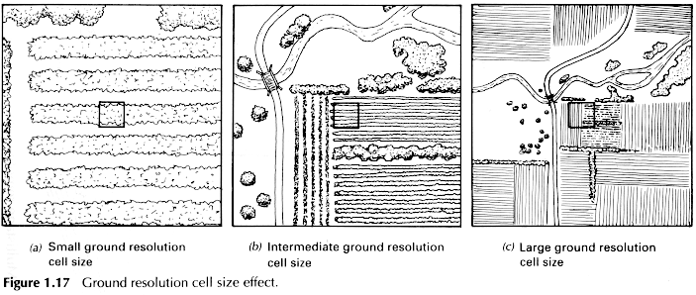
Spatial resolution: refers to the pixel size, cell size, or instantaneous field of view (IFOV)
Typically the lower the flying height the greater the detail (larger scale), smaller the individual pixel size
Trade-offs exist between high spatial resolution and overall ground area encompassed by an image
As a general rule of thumb, in order to detect and/or map spatial objects on the ground, the pixel size should be about 1/3 the size of the object
High spatial resolution
Intermediate spatial
resolution
Low spatial resolution

Slide 14
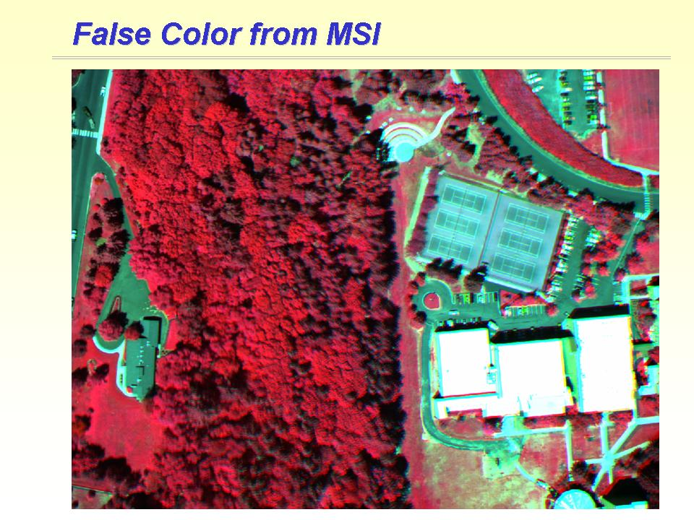
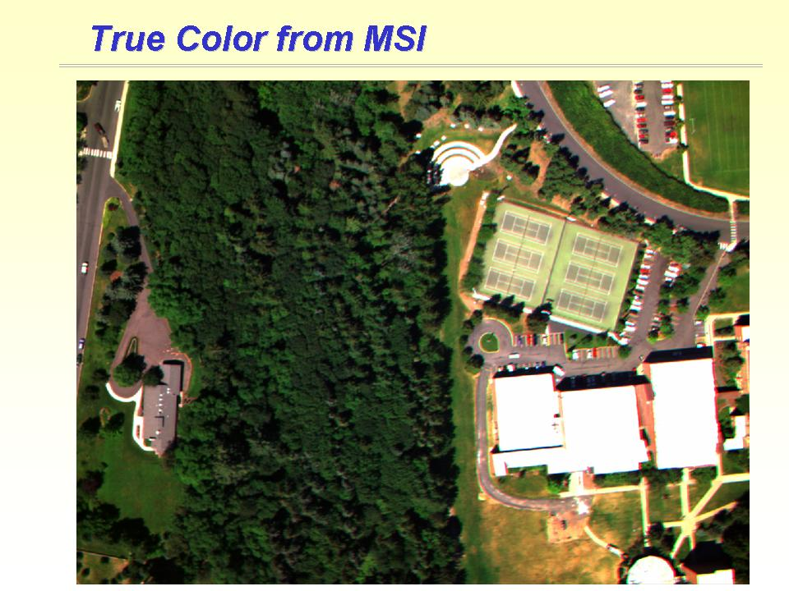
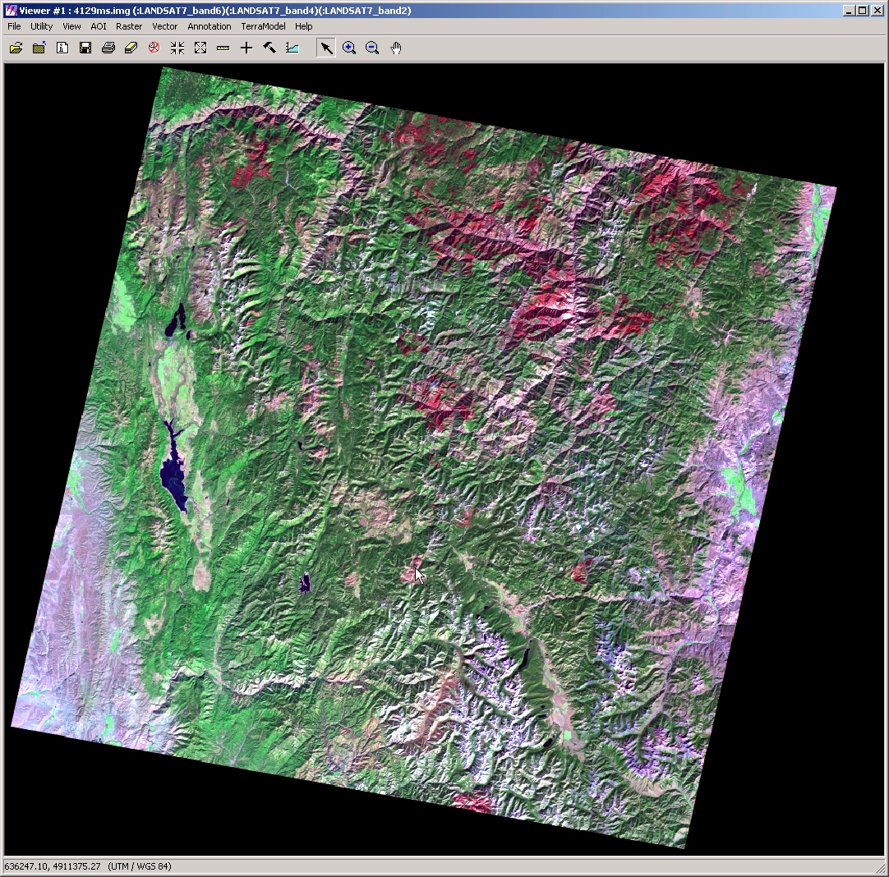
The value of remote sensing
Trade-offs exist between high spatial resolution and overall ground area encompassed by an image
However, remote sensing and the overhead perspective also provide us with a unique ability to perceive context, adjacency and spatial patterns. Digital images allow us to quickly zoom and pan so that we can look at context as well as detail – such as orthographic vs. perspective
Computers and digital imaging technologies provide a tremendous expansion of our ability to map and monitor at a variety of scales and perspectives.
Satellite images vs. aerial photos – digital technologies have bridged the gaps and differences
Remote sensing images provide a permanent record of ground conditions/patterns at a point in time

Slide 15
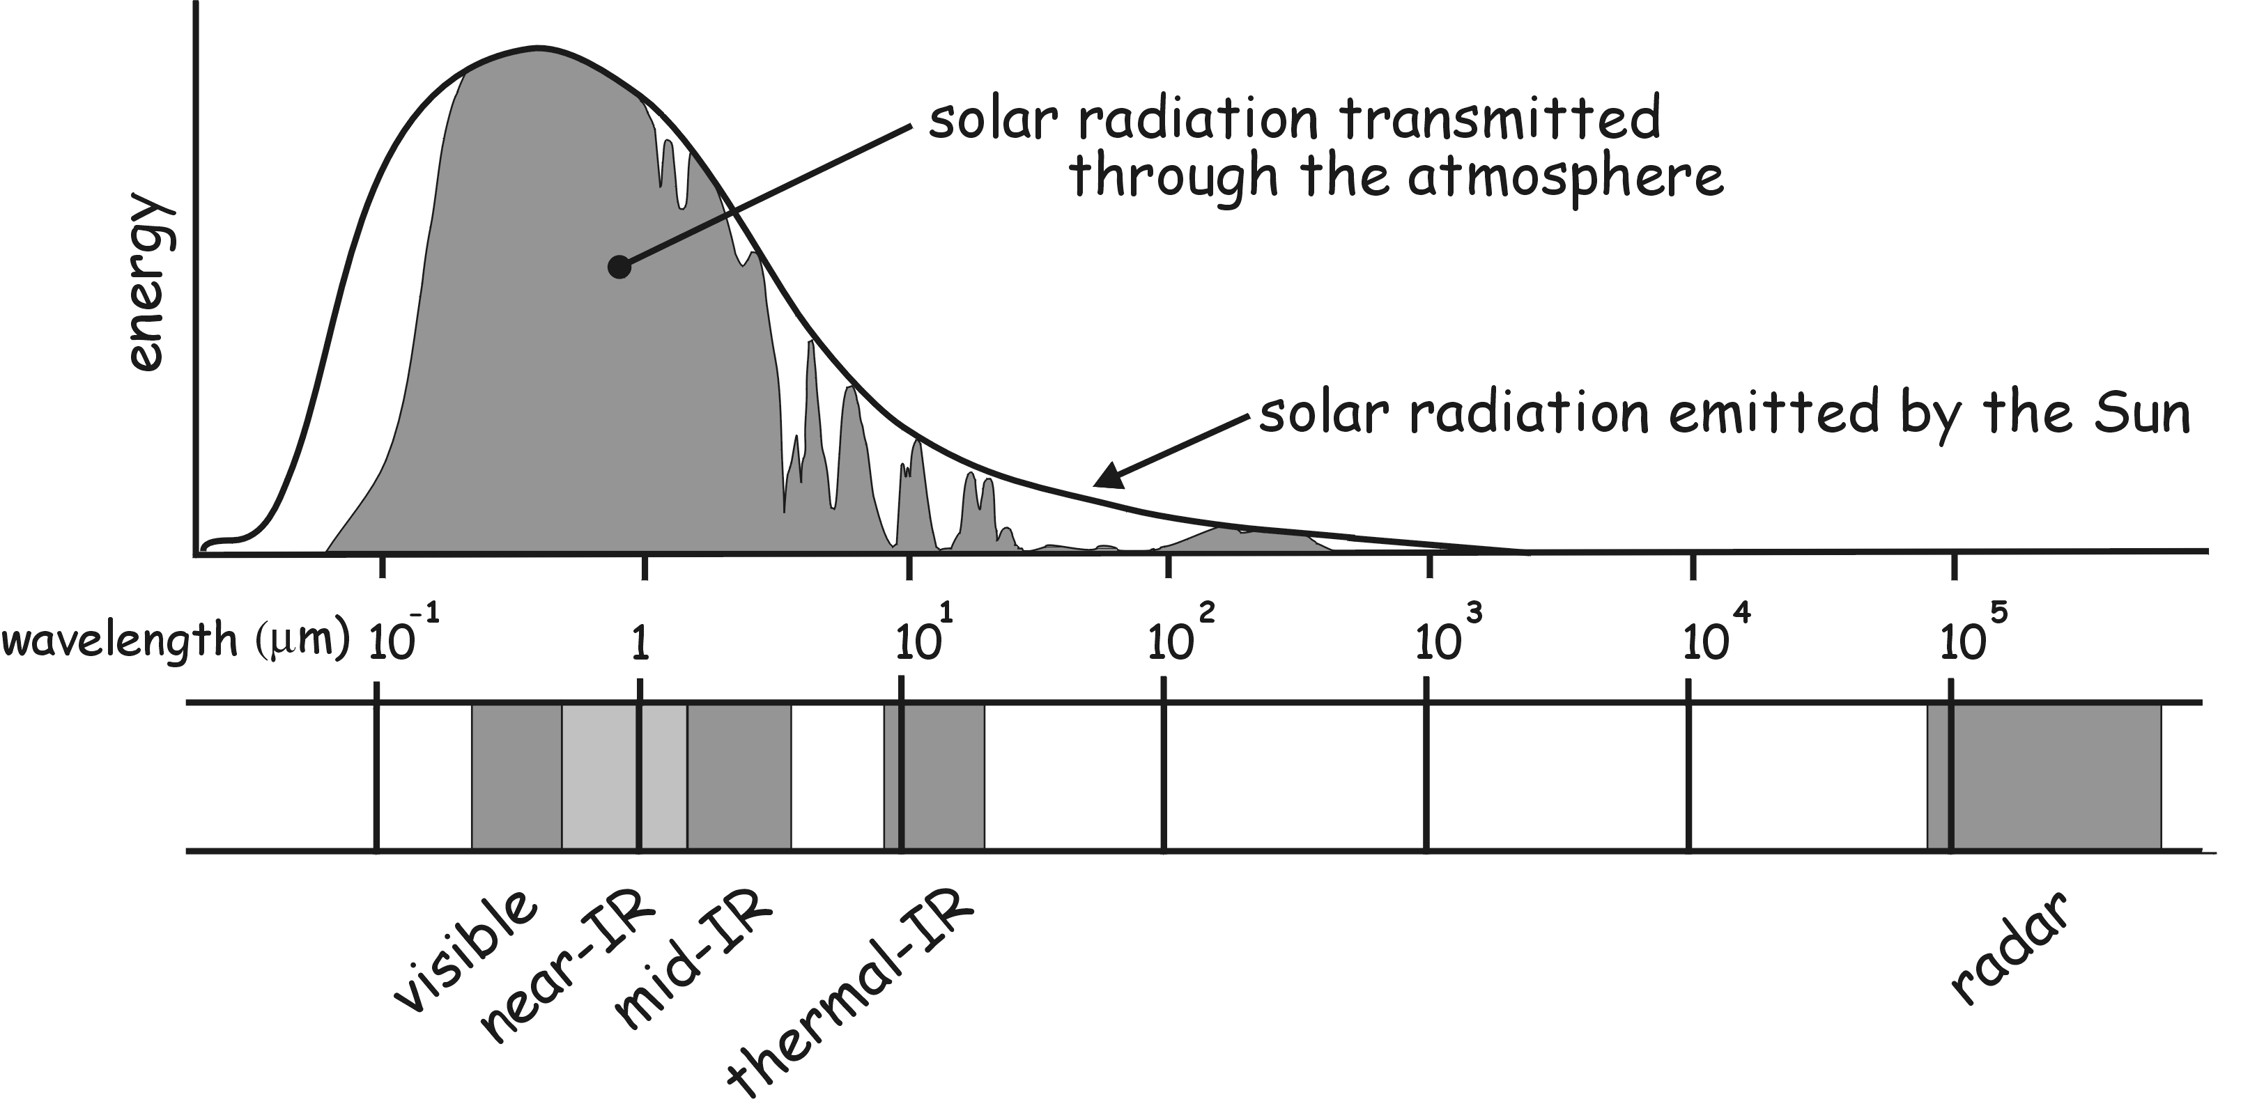
Electromagnetic Spectrum (EM) and Wavelengths
Light can be divided up into bands that have differing wavelengths.
Objects of differing composition (trees, grass, rocks) reflect the varied wavelengths of light in differing ways.

Slide 16
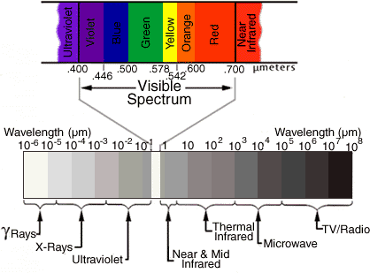
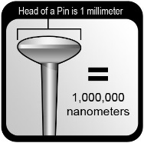
Spectral Resolution
Spectral resolution: refers to the number of colors or spectral bands we can acquire with a particular sensor or camera
Traditional cameras capture visible wavelengths of light (B,G,R), and many newer sensors can capture or image wavelength bands (channels) outside of the visible spectrum (NIR, MIR, TIR). A band refers to a range along the electromagnetic spectrum. (Red band = ~.6-.7 µmeters)

Slide 17
Spectral Profiles
Characteristic curves for different earth surface phenomena
These variations in reflectance cause differences in brightness as captured on film

Slide 18
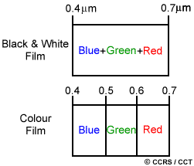
Spectral Resolution
Spectral resolution describes the ability of a sensor to define fine wavelength intervals.
The finer the spectral resolution, the narrower the wavelength range for a particular channel or band.

Slide 19
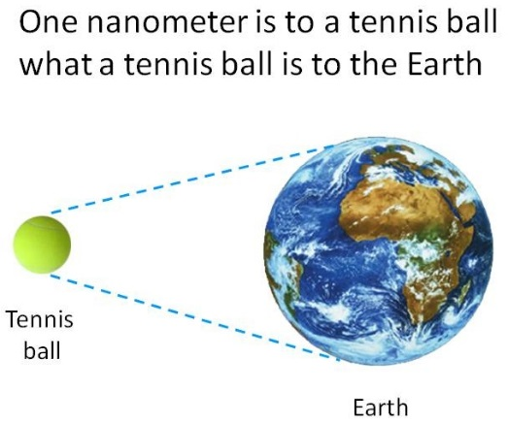

What is a nanometer?
A nanometer is a unit of spatial measurement that is 10⁻⁹ meter, or one billionth of a meter.

Slide 20
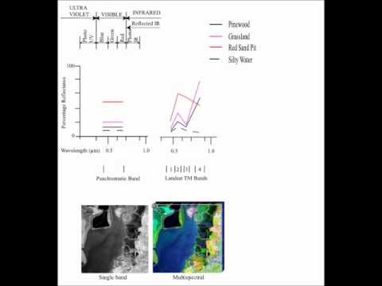
Spectral Resolution in 3 Min

Slide 21
Remote Sensors
Image Extent – the area covered by an image, and depends on the physical size of the sensing area (sd), the camera focal length (h) and the flying height (H).
GD = sd * H /h
The ground resolution on aerial images can be determined by substituting the cell dimension for sensor dimension
GD = cd * H /h

Slide 22
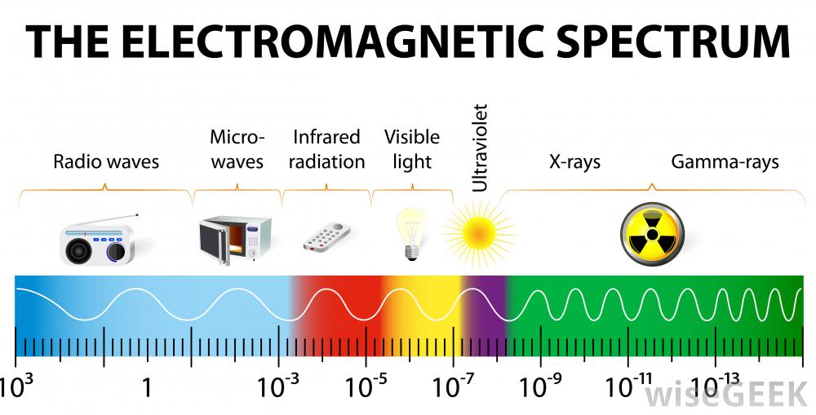

Slide 23
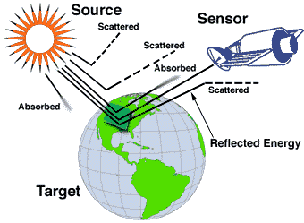
Spectral resolution

Slide 24
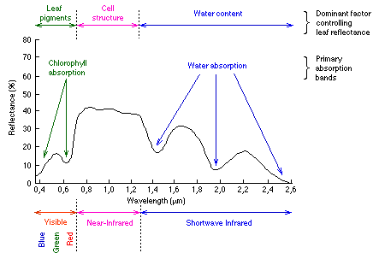
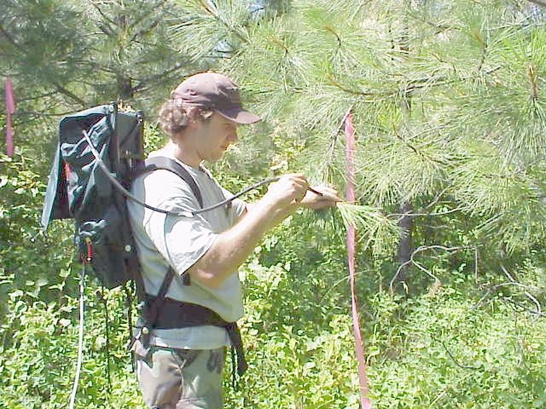
Spectral resolution

Slide 25
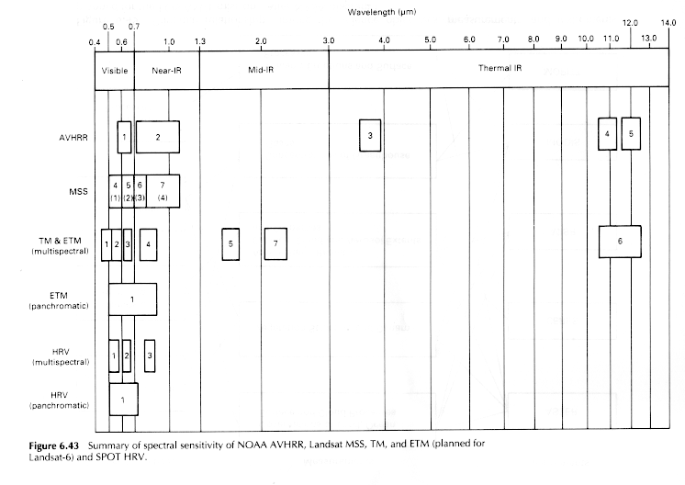
Spectral resolution
Hyperspectral (224 channels)
(Lillesand & Kiefer, 1996)

Slide 26
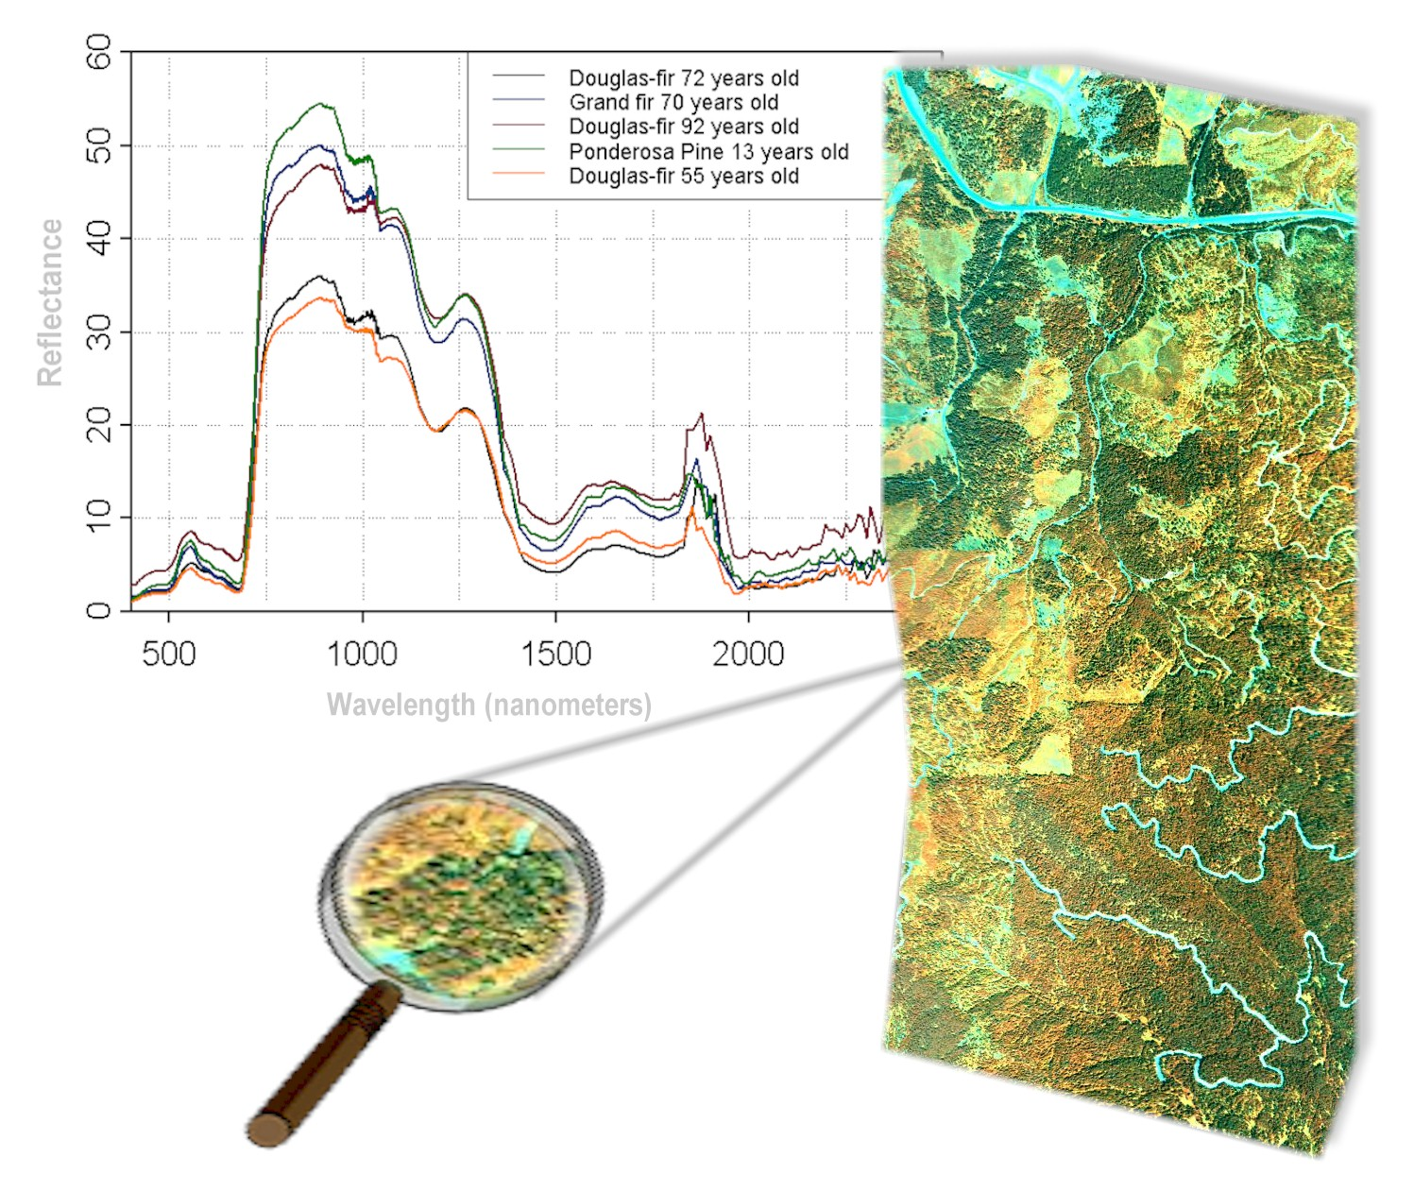

Slide 27
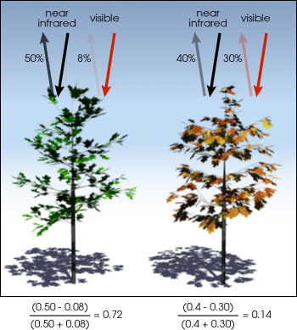
NIR - visible
The normalized difference vegetation index (NDVI) is a simple graphical indicator that can be used to analyze remote sensing measurements, typically but not necessarily from a space platform, and assess whether the target being observed contains live green vegetation or not.
Normalized Difference Vegetation Index: NDVI =
NIR + visible

Slide 28
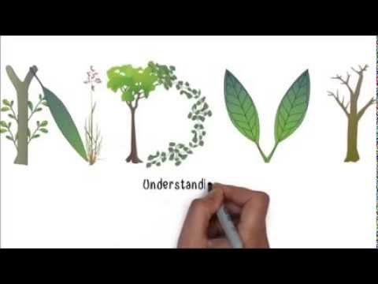
NDVI

Slide 29
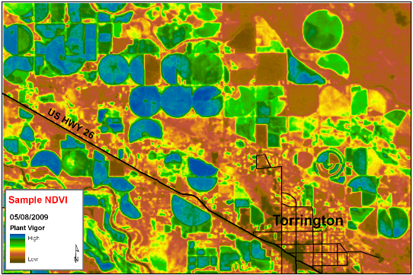
Normalized Difference Vegetation Index (NDVI)
NIR - visible
The pigment in plant leaves, chlorophyll, strongly absorbs visible light (from 0.4 to 0.7 µm) for use in photosynthesis.
The cell structure of the leaves, on the other hand, strongly reflects near-infrared light (from 0.7 to 1.1 µm). The more leaves a plant has, the more these wavelengths of light are absorbed, respectively.
By exploiting the strong differences in plant reflectance, we can determine their spatial distribution
NIR + visible
NDVI can be used to quantify the photosynthetic capacity of plant canopies.

Slide 30

Notes:
Poll Title: Which of these two images has the larger ground resolution? https://www.polleverywhere.com/multiple_choice_polls/LRk00FernSNV9N9

Slide 31
Notes:
Poll Title: Image extent is the area covered by an image, and depends on 1) the camera focal length (h); 2) the flying height (H); and... https://www.polleverywhere.com/multiple_choice_polls/rRbEfgZr4Qt4PKZ

Slide 32
Notes:
Poll Title: Spectral resolution is increased as... https://www.polleverywhere.com/multiple_choice_polls/6fBSKm31JWPbhhd

Slide 33
END of Lecture Part 1

Slide 34
temporal resolution
Temporal resolution refers to the frequency with which we can acquire repeat images of the same area on the ground
Different applications require different temporal resolutions. Topographic mapping vs. crop monitoring
Mapping – often only requires one point in time
Monitoring – requires repeat coverage to quantify changes that have occurred
Satellites typically have a fixed orbit Landsat – covers the same location every 16 days, some satellite have “pointable” optics
Airborne sensors can be flown whenever needed – depending on available funds
Alternative RS options are beginning to become affordable (kites, drones)

Slide 35
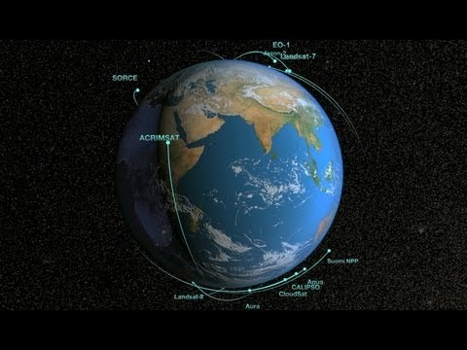

Slide 36
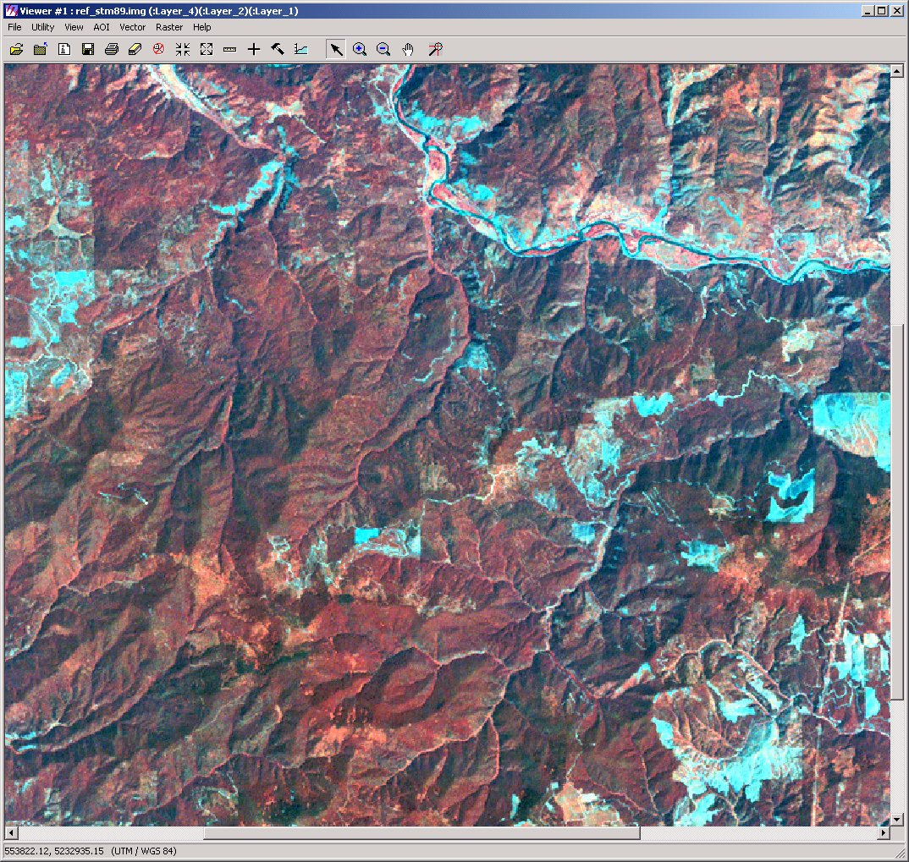
Forest monitoring maps
Can use multi spectral imagery for annual regional assessments
1989
Notes:
Conclusions & presentation of center concept

Slide 37
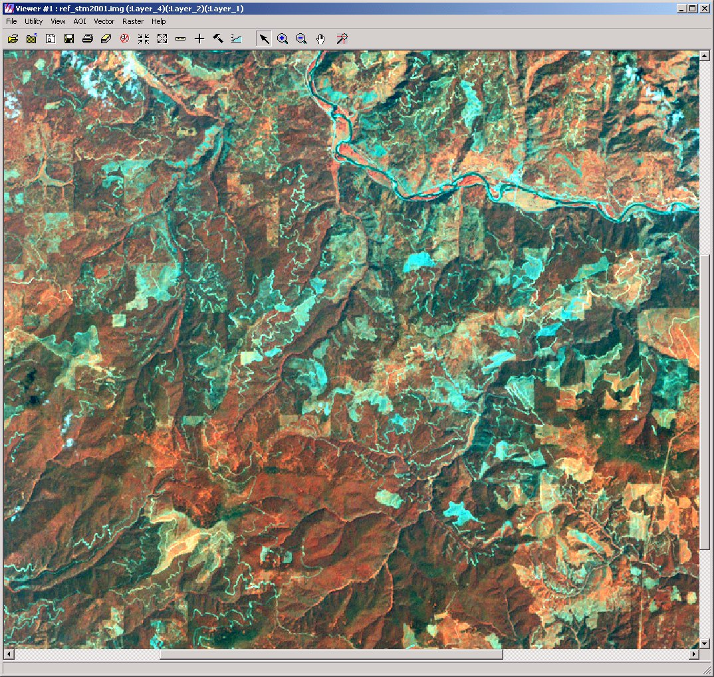
Forest monitoring maps
2001

Slide 38
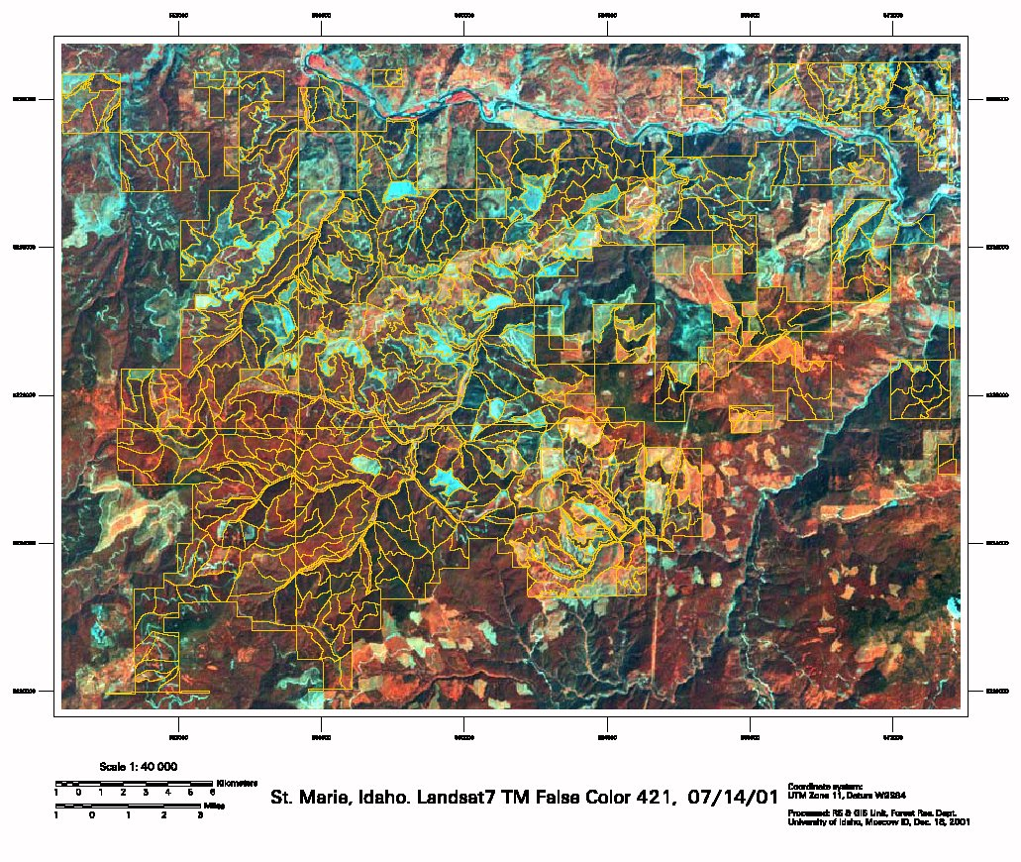
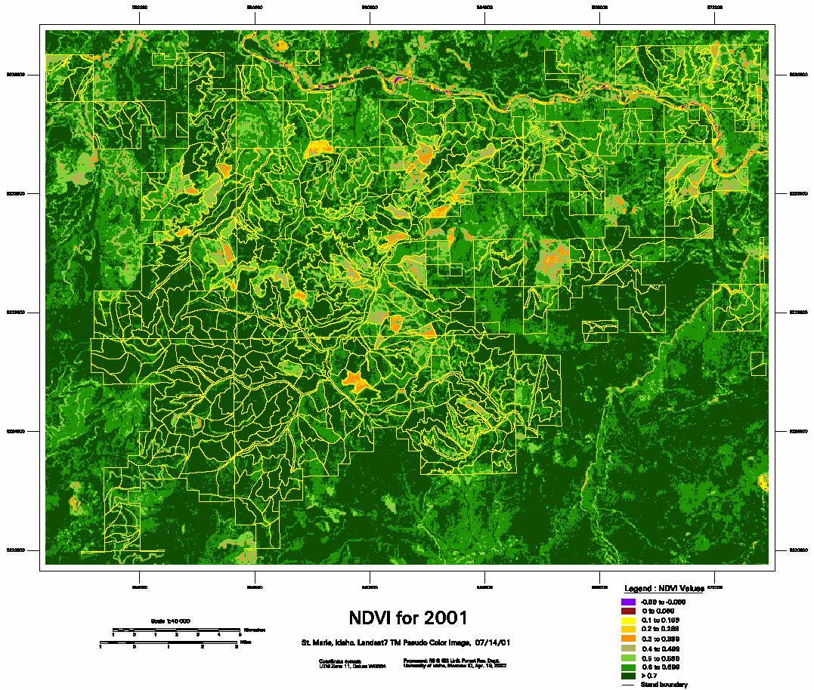
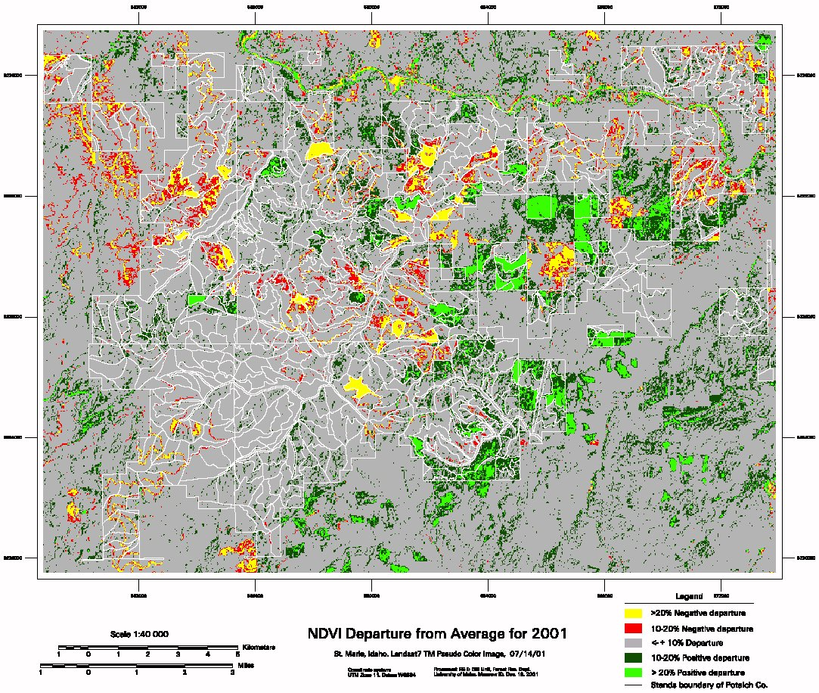

Slide 39
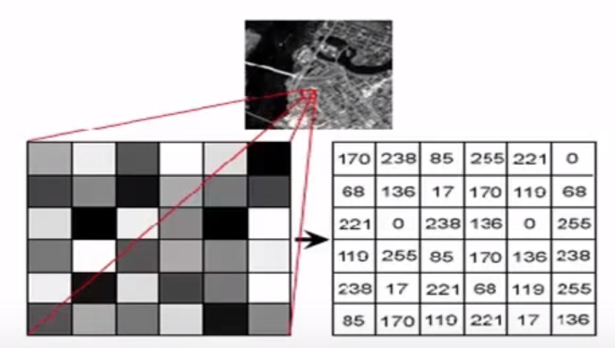
Radiometric Resolution
The smallest “slice” of a band or portion of the EM spectrum in which the reflectance of the feature may be assigned a digital number.
In other words, the finest distinctions that can be made between objects viewed in the same part of the EM spectrum.
Scanning systems with a 2⁶ (64 bit) radiometric resolution are not able to make as many distinctions as a scanning system with a 2⁸ (256 bit) radiometric resolution

Slide 40
Radiometric resolution
The higher the radiometric resolution, the more sensitive the sensor is to detecting small differences in emitted energy
Higher radiometric resolution is especially important for quantitative applications such as sea-surface temperature mapping where the user wants to distinguish small differences in temperature.

Slide 41
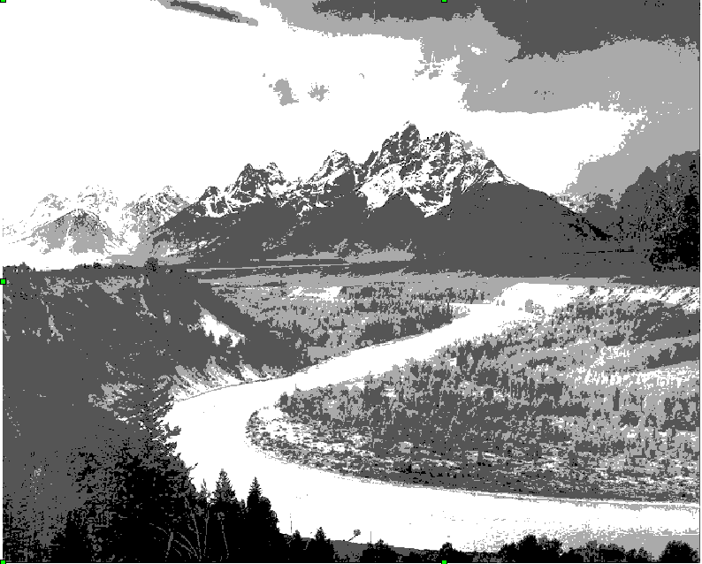
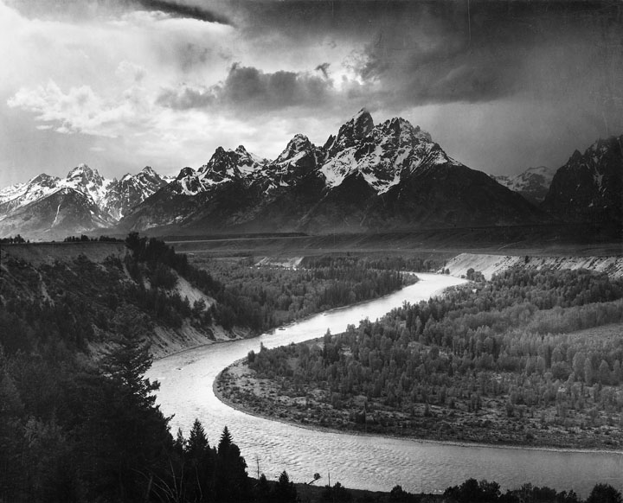
2-bit = 4 radiance levels
8-bit = 256 radiance levels
The finer the radiometric resolution of a sensor, the more sensitive it is to detecting small differences in reflected or emitted energy.

Slide 42
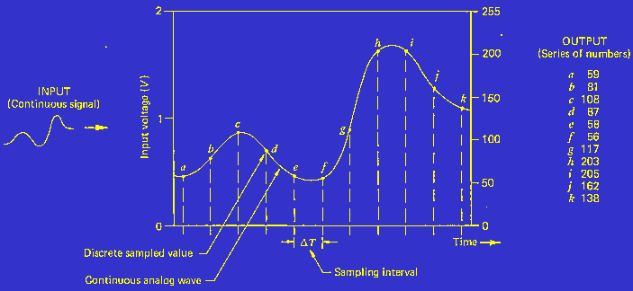
Radiometric resolution refers to the number of brightness levels we can sense for a particular wavelength band

Slide 43
Radiometric resolution
We can represent Radiometric or brightness variations in a digital image in three principal ways:
Digital number;
radiance (physical value);
reflectance
Reflectance has become the standard, represents as ratio of the incoming radiation to the amount that is reflected

Slide 44
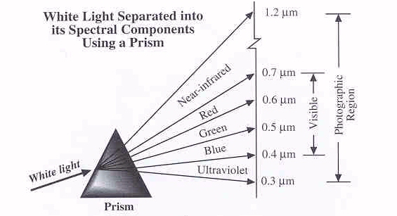
The regions of the spectrum that photographic film/ or
digital sensors can record:
Ultraviolet, visible, near-infrared

Slide 45
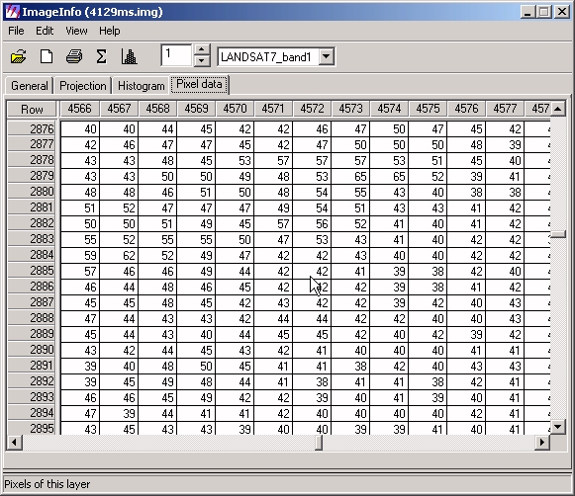
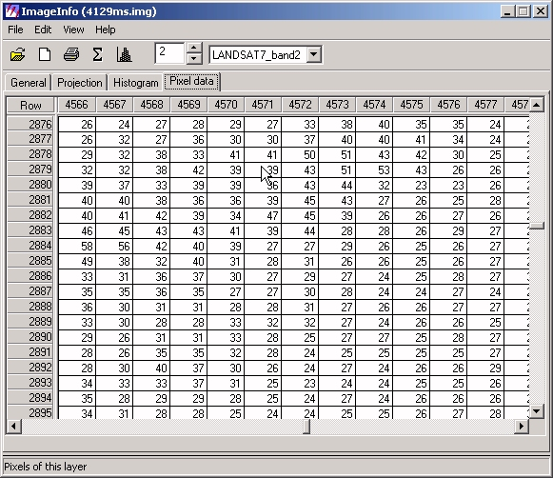

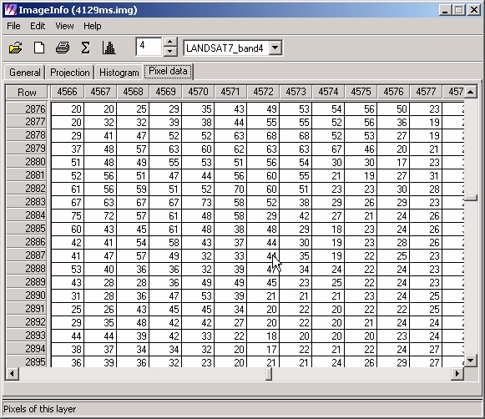
Band/channel 1 = G (.5-.6 μm)
Digital images: what are they??
B2 = R (.6-.7 μm)
B3 = NIR (.72-.9 μm)
B4 = ThIR (8.0-9.2 μm)
Hyperspectral bands: 10nm widths (.001 μm)
…

Slide 46
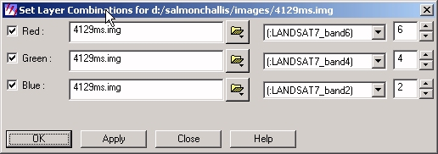

Slide 47









Slide 48





Slide 49





Slide 50

How do we extract information from images?

Slide 51

Land cover and land use classification is a common application of satellite images. The spectral reflectance patterns of each cover type are used to assign a unique land cover class to each cell. These data may then be imported into a GIS as a raster layer (Bolstad, 2014).

Slide 52



251
251
252
252
Can analyze digital images using computer processing techniques, however, the most sophisticated and powerful computer is the human eye/brain combination

Slide 53



Slide 54

We can remotely:
discriminate tree species;
discriminate differences in tree spectral responses due to specific parent material differences;
discriminate differences in foliar chemistry due to fertilization (increased absorption of PAR, chlorophyll, cell structures);
discriminate differences in tree physiological condition due to stress (water, insects, disease)

Slide 55

Airborne Visible Infrared Imaging Spectrometer
224 contiguous spectral channels (also called bands) with wavelengths from 400 to 2500 nanometers (nm).

Slide 56
Introduction to remote sensing – what you should know
What you should know:
what remote sensing is and how it can be used for obtaining primary data
value of the overhead perspective – context, patterns, adjacencies
basic concepts of spatial, spectral, temporal and radiometric resolution
converting raw spectral images into information outputs or maps – image classification using statistical classifiers

